Slide 1

Software Design (swD392)
Ch17 - Designing Component-Based Software Architectures

Slide 2
Main Contents
Overview
Designing Distributed Component-Based Software Architectures
Composite Subsystems and Components
Modeling Components with UML
Component Structuring Criteria
Group Message Communication Patterns
Application Deployment

Slide 3
Overview
A given software application could be configured to have each component-based subsystem allocated to its own separate physical node, or, alternatively, to have all or some of its components allocated to the same physical node.
A component-based development approach helps achieve the goal of a distributed, highly configurable, message-based design.
A distributed component is a concurrent object with a well-defined interface.
A composite component is composed of other part components. A simple component has no part components within it.
A source component on one node sends a message over the network to a destination component on a different node.

Slide 4
Designing Distributed Component-Based Software Architectures
A distributed application consists of distributed components that can be configured to execute on distributed physical nodes.
Design distributed software architecture: Structure the distributed application into constituent components that potentially could execute on separate nodes in a distributed environment.
Design constituent components: a simple component can execute on only one node, the internals of each simple component can be designed by means of a design method for sequential object-oriented software architectures
Deploy the application. After a distributed application has been designed, instances of it can be defined and deployed.
Notes:
constituent components: thành phần cấu thành

Slide 5
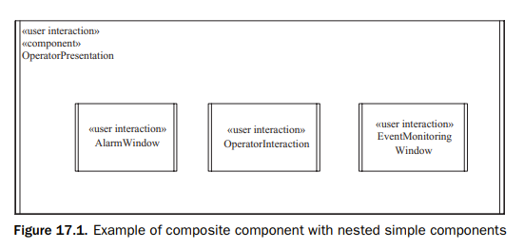
Composite Subsystems and Components
A composite subsystem is a component that encapsulates the internal components (objects) it contains. The component is both a logical and a physical container, but it adds no further functionality; thus, a component’s functionality is provided entirely by the part components it contains.
Incoming messages to a component are passed through to the appropriate internal destination component, and outgoing messages from an internal component are passed through to the appropriate external destination component
Notes:
Composite: tổng hợp

Slide 6
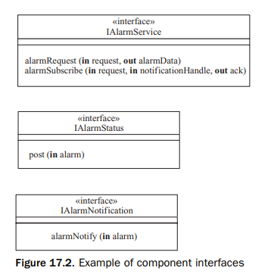
Modeling Components with UML Design of Component Interfaces
An interface specifies the externally visible operations of a class or component without revealing the internal structure (implementation) of the operations.
Although many components are designed with one interface, it is possible for a component to provide more than one interface. If different components use a component differently, it is possible to design a separate interface for each component that requires a different interface.

Slide 7
Modeling Components with UML Provided and Required Interfaces 1/2
A provided interface specifies the operations that a component must fulfill.
A required interface describes the operations that other components provide for this component to operate properly in a particular environment.
In particular, if a component communicates with more than one component, it can use a different port for each component with which it communicates.

Slide 8
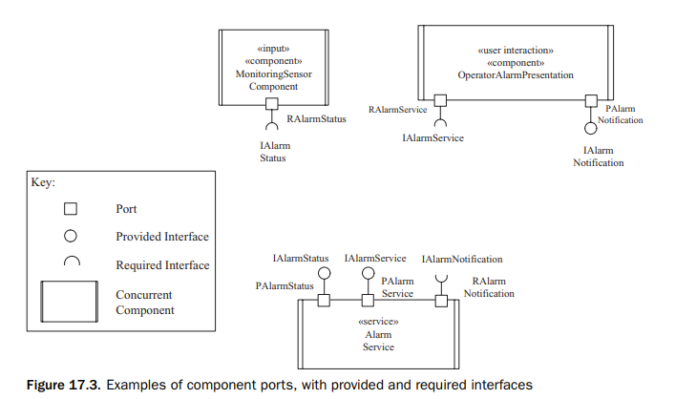
Modeling Components with UML Provided and Required Interfaces 2/2

Slide 9
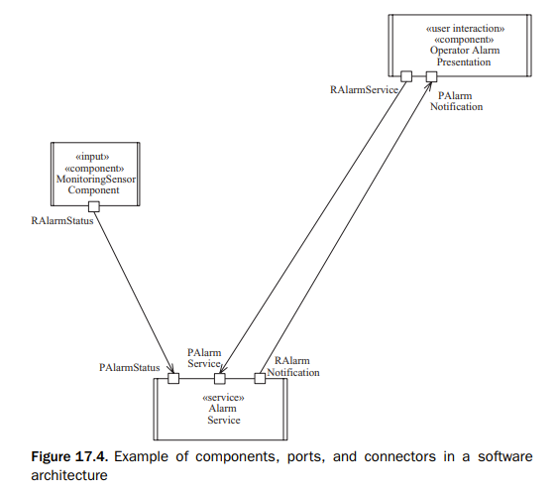
Modeling Components with UML Connectors & Interconnecting Components
A connector joins the required port of one component to the provided port of another component.
The connected ports must be compatible with each other.

Slide 10
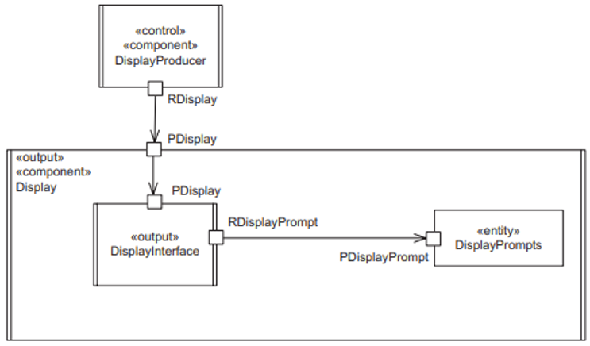
Modeling Components with UML Designing Composite Components
A composite component is structured into part components, which are also depicted as UML structured classes.
A component with no internal components is referred to as a simple component.

Slide 11
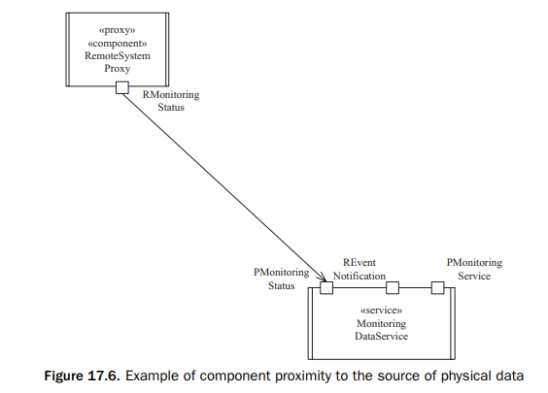
Component Structuring Criteria Proximity to the Source of Physical Data
In a distributed environment, the sources of data might be physically distant from each other. Designing the component so that it is close to the source of physical data ensures fast access to the data, which is particularly important if data access rates are high.
Notes:
Proximity: tiệm cậna

Slide 12
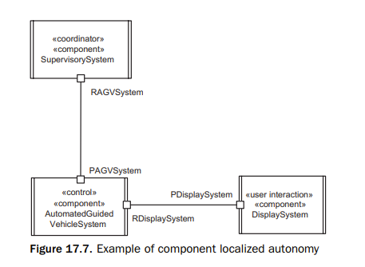
Component Structuring Criteria Localized Autonomy
A distributed component often performs a specific site-related service, where the same service is performed at multiple sites. Each instance of the component resides on a separate node, thereby providing greater local autonomy.
An example of an autonomous local component is the Automated Guided Vehicle System component of the Factory Automation System
Notes:
Localized Autonomy: tự chủ cục bộ

Slide 13
Component Structuring Criteria Performance
If a time-critical function is provided within a node, better and more-predictable component performance can often be achieved.
In a given distributed application, a real-time component can perform a time-critical service at a given node, with non– real-time or less time-critical services performed elsewhere.
An example of a component that satisfies this criterion is the Automated Guided Vehicle System component

Slide 14
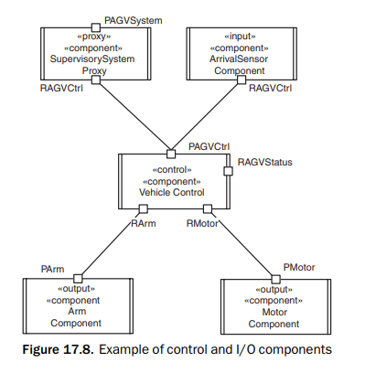
Component Structuring Criteria Specialized Hardware
A component might need to reside on a particular node because it supports special-purpose hardware, such as a vector processor, or because it has to interface to special-purpose peripherals, sensors, or actuators that are connected to a specific node
Instances of the Monitoring Sensor Component (Figure 17.4) interface to special-purpose sensors. Both the Arm Component and Motor Component (Figure 17.8) interface to special-purpose actuators.
Notes:
Actuators: thiết bị truyền động

Slide 15
Component Structuring Criteria I/O Component
An I/O component can be designed to be relatively autonomous and in close proximity to the source of physical data.
In particular, “smart” devices are given greater local autonomy and consist of the hardware plus the software that interfaces to and controls the device.
I/O component is a general name given to components that interact with the external environment
Notes:
Actuators: thiết bị truyền động

Slide 16
Group Message Comm. Patterns
The message communication patterns described so far have involved one source component and one destination component.
A desirable property in some distributed applications is group communication. This is a form of one-to-many message communication in which a sender sends one message to many recipients.
Two kinds of group message communication (sometimes referred to as groupcast communication) supported in distributed applications are broadcast and multicast communication.

Slide 17
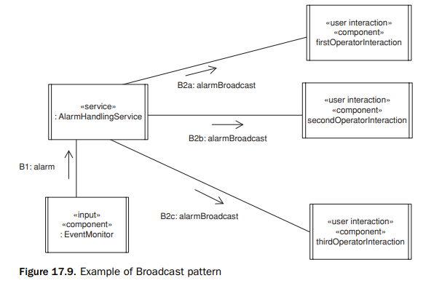
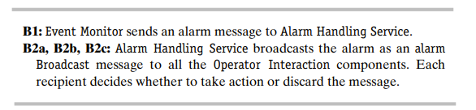
Group Message Comm. Patterns Broadcast Message Communication Pattern
With the Broadcast (or Broadcast Communication) pattern, an unsolicited message is sent to all recipients, perhaps informing them of a pending shutdown. Each recipient must then decide whether it wishes to process the message or discard it.
Notes:
Unsolicited: ko được yêu cầu

Slide 18
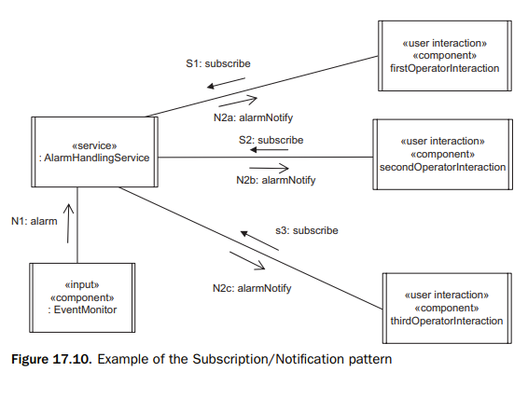
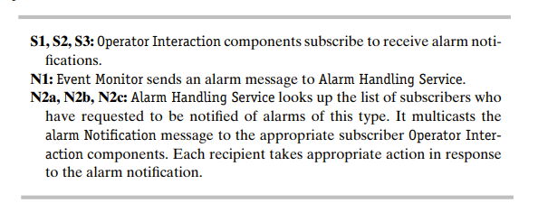
Group Message Comm. Patterns Subs/Noti Message Communication Pattern
Multicast communication provides a more selective form of group communication, in which the same message is sent to all members of a group.
The Subscription/Notification pattern uses a form of multicast communication in which components subscribe to a group and receive messages destined for all members of the group.
Notes:
Unsolicited: ko được yêu cầu

Slide 19
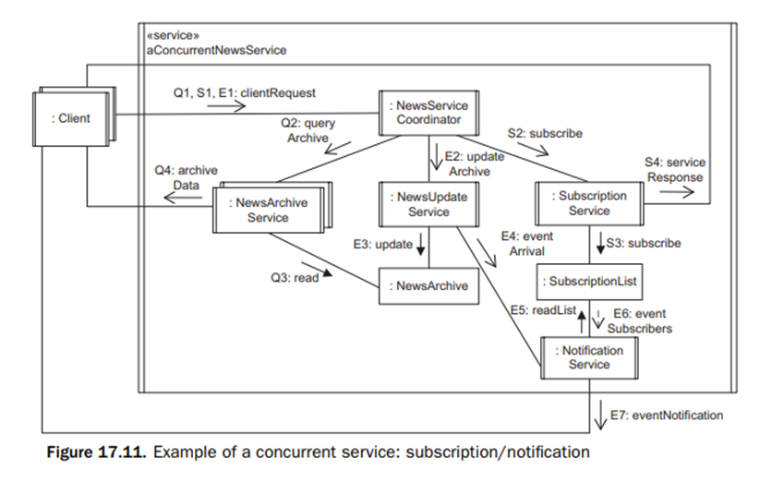
Group Message Comm. Patterns Concurrent Service Design with Subs/Noti 1/2
Notes:
Unsolicited: ko được yêu cầu

Slide 20
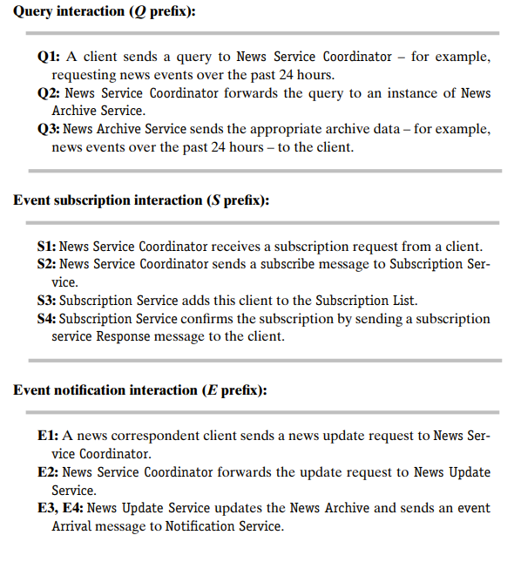
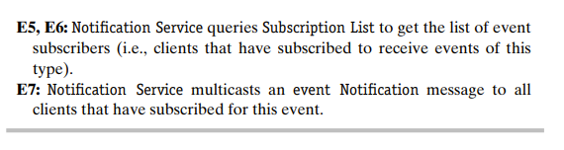
Group Message Comm. Patterns Concurrent Service Design with Subs/Noti 2/2
The concurrent communication diagram in Figure 17.11 shows three separate interactions: a simple query interaction, a news event subscription interaction, and a news event notification interaction.
In the query interaction (which does not involve a subscription), a client makes a request to News Service Coordinator, which in turn sends a news archive query to News Archive Service. The latter queries the News Archive and sends the response directly to Client.
Notes:
Unsolicited: ko được yêu cầu

Slide 21
Application Deployment Application Deployment Issues 1/3
Define instances of the component. For each component that can have multiple instances, it is necessary to define the instances desired.
Interconnect component instances. The application architecture defines how components communicate with one another.
Map the component instances to physical nodes. For example, two components could be deployed such that each one could run on a separate physical node. Alternatively, they could both run on the same physical node. The physical configuration of the target application is depicted on a deployment diagram.

Slide 22
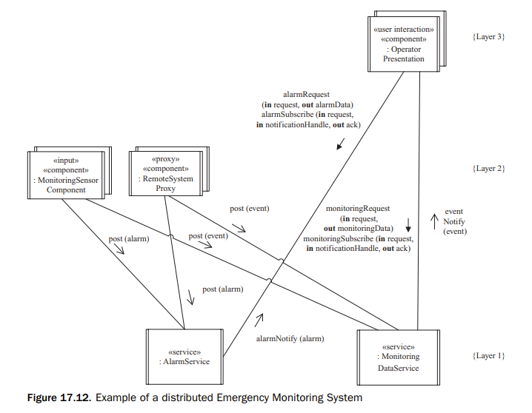
Application Deployment Application Deployment Issues 2/3

Slide 23
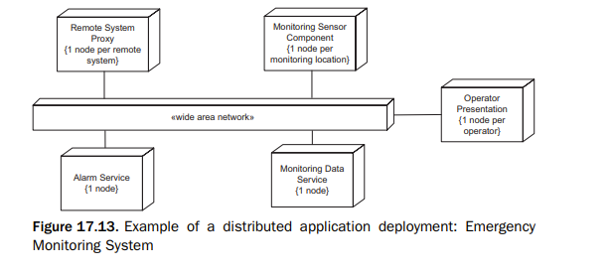
Application Deployment Application Deployment Issues 3/3

Slide 24


